Slide 1
The empty fridge app
Sophie, Anna & Yasmin
‘Py and Mash’

Slide 2
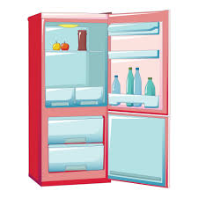
The problem

Slide 3

Must
1. Read the API documentation. 2. Ask user to enter an ingredient. 3. Create a function that makes a request to the API. 4. Get the returned recipes. 5. Display the recipes for each search result.
Should
Store recipes in a CSV file.
Select recipes based on dietary requirements.
Could
1. Find a movie recommendation.
2. Ask the user to choose a recipe, and store ingredients in a shopping list.
Won’t (but could in the future!)
Save preferred recipes to a favourites list.
→ Divided up tasks and added to Google Colab

